Slide 1
Plant Growth

Slide 2
Spec

Slide 3
Learning outcomes
Evaluate the experimental evidence for the role of auxins in the control of apical dominance and gibberellin in the control of stem elongation.

Slide 4
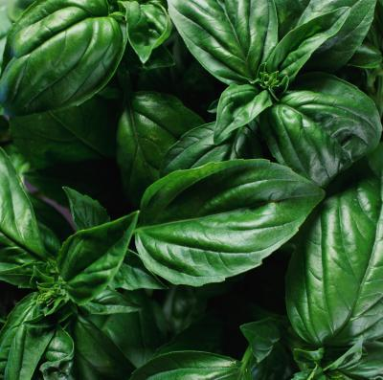
Starter
Where does plant growth originate?
How do plants get ‘bushier’?
Why does this technique work?
“Prune or pinch off the ends of stems as the plant develops, leaving only two to four leaves, going back to just above a leaf node -- the swelling between the stem and the leaf's stem. The plant will branch out from this point on each stem you pinch into two to four new branches that can be harvested in about three weeks”

Slide 5
Why “plant growth regulators”?
Exert influence by affecting growth
Produced in a region of plant structure by unspecialised cells
Some are active at the site of production
Not specific – can have different effects on different tissues

Slide 6
The Plant growth regulators
There are five main groups
Auxins
Gibberellins
Cytokinins
Abscisic acid
Ethene

Slide 7
Plant growth regulators
Produced in small quantities
Are active at site of production, or move by diffusion, active transport or mass flow.
Effects are different depending on concentration, tissues they act on and whether there is another substance present as well.

Slide 8
Interaction of plant growth regulators
Synergism
2 or more act together to reinforce an effect
Antagonism
Have opposing actions and inhibit (diminish) each others effects.

Slide 9
Auxins
Synthesised in shoot or root tips.
Most common form is IAA (indole-3-acetic acid a.k.a. indoleacetic acid)
Main effects of auxins include:
Promote stem elongation
Stimulate cell division
Prevent leaf fall
Maintain apical dominance.

Slide 10
Auxins and Apical Dominance
Auxins produced by the apical meristem
Auxin travels down the stem by diffusion or active transport
Inhibits the sideways growth from the lateral buds

Slide 11
Apical Dominance

Slide 12
Apical Dominance

Slide 13
Mechanism for apical dominance
Auxin made by cells in the shoot tip
Auxin transported downwards cell to cell
Auxin accumulates in the nodes beside the lateral buds
Presence inhibits their activity

Slide 14
Task
Plant Hormones and Applications Worksheet

Slide 15
Answers
1a) Stem elongation
1b) Cell Division
1c) Fruit Ripening
1d) Open and Close Stomata
2a) Inhibits the activity of the lateral buds
2b) Promotes cell enlargement
2c) Growth of the secondary vascular tissues
3) Removes apical dominance
4a) Cytokinins
4c) Cytokinins
4d) Abscisic acid
5a) Auxin/Giberellins
5b) Ethene/Abscisic Acid

Slide 16
Evidence for mechanism (1)
If the tip is cut off of two shoots
Indole-3-acetic-acid (IAA) is applied to one of them, it continues to show apical dominance
The untreated shoot will branch out sideways

Slide 17
Evidence for mechanism (2)
If a growing shoot is tipped upside down
Apical dominance is prevented
Lateral buds start to grow out sideways
This supports the theory
Auxins are transported downwards, and can not be transported upwards against gravity

Slide 18
Task
Transport and Effects of Auxins worksheet

Slide 19
Answers
1a) Auxin inhibits lateral bud growth
1b) Promote cell elongation
1c) Promotes differentiation of cambium
2) Removal of apical bud, removes the auxin, stops the inhibition of lateral bud growth
3) Gradients in auxin concentration (has different effects at high and low levels), can effect different tissues as moves by diffusion

Slide 20
Question
Suggest how apical dominance could be an advantage to a plant!

Slide 21
Suggest!!

Slide 22
Gibberellins and stem elongation
Gibberellin (GA) increases stem length
Increases the lengths of the internodes
Stimulating cell division
Stimulating cell elongation

Slide 23
Evidence for GA and stem elongation
Dwarf beans are dwarf because they lack the gene of producing GA
Mendel’s short pea plants lacked the dominant allele that encodes for GA
Plants with higher GA concentrations are taller

Slide 24
Action of GA
Affects gene expression
Moves through plasma membrane into cell
Binds to a receptor protein, which binds to other receptor proteins eventually breaking down DELLA protein.
DELLA proteins bind to transcription factors
If DELLA protein is broken down, transcription factor is released and transcription of the gene can begin

Slide 25
Gibberellins and Seed Germination
Stimulus: see absorbs water
Response: Embryo releases gibberellins
Enables production of amylase
Starch broken down to glucose
Glucose can be respired
Glucose can be made into proteins

Slide 26
Investigating role of plant hormones
Remember for control experiments the following are important:
Large sample size
Randomly assign individuals to groups
Repeat the measurements
When drawing conclusions – remember that a correlation between two variables does not mean that a change in one causes a change in the other.

Slide 27
Task
Worksheet Apical Dominance, Bolting & Leaf Loss
DO NOT DO Q4

Slide 28
Answers
1) Auxin inhibits lateral bud growth
2) Stimulates cell elongation and division
3a) Remove apical bud = lateral growth; remove apical bud and auxin applied = no lateral growth
3b) Tall plants have higher levels of giberellins; applying giberellins to short plants and they grow tall

