Slide 1
Proteins:Amino acids

Slide 2
Need to book
Molymods (C,H,O & N) each group needs 16 single bonds, 4 double bonds, 4 Carbon, 2 Nitrogen, 4 oxygen, 10 hydrogen
Practical activity 21
ALSO! Need to give Mel 2 weeks notice on the chromatography prac in lesson 11
Repro
Practical activity 21 worksheet
Summary Sheet
PPQ (on slide but can repro)

Slide 3
Success Criteria
Learning Objective
Know about the primary structure of proteins
Describe the structure of an amino acid
Describe the formation and breakage of peptide bonds
Explain the term primary structure
Describe the test for protein

Slide 4
Starter
Draw the structure of a protein and label it in as much detail as you can

Slide 5
Amino Acid
- Describe the structure of an amino acid
Acid Group
Amino Group
R Group
Notes:
Acid group also known as carboxyl group

Slide 6
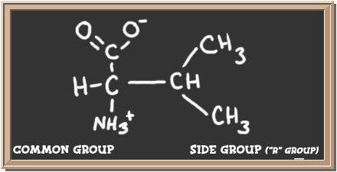
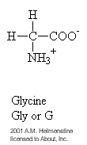
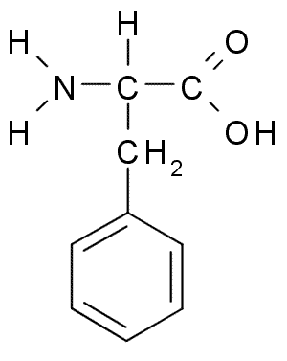
Examples of Amino Acids with different R Groups
- Describe the structure of an amino acid
Valine
Phenylalanine

Slide 7
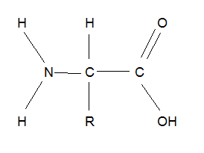
Task
- Describe the structure of an amino acid
- Describe the formation and breakage of peptide bonds
- Explain the term primary structure
- Describe the test for protein
Make a model using molymods

Slide 8
Formation of a Dipeptide
- Describe the formation and breakage of peptide bonds
Condensation Reaction
Hydrolysis Reaction
Peptide Bond
+ H₂0

Slide 9
Hydrolysis of Peptide Bonds
- Describe the formation and breakage of peptide bonds
The covalent bond that forms the peptide bond is strong, it must be broken apart by an enzyme
Enzymes that breakdown proteins are called proteases
Examples of protease activity other than digestion:
Hormone regulation
Ageing
P101 in book

Slide 10
Task
- Describe the structure of an amino acid
- Describe the formation and breakage of peptide bonds
Make another model of an amino acid to make a model using of peptide bond formation

Slide 11
Proteins
- Explain the term primary structure
The function of each protein is determined by its structure
A protein’s structure is firstly determined by its amino acid sequence

Slide 12
Key Term: Primary Structure
- Explain the term primary structure
The specific sequence of amino acids that make up a protein
Task GCSE Recap: how is this sequence coded for?
Notes:
Answer to task is covered in nucleotides module in detail but useful to make the link between the knowledge now

Slide 13
Making A polypeptide chain
DNA strands code for protein structure
This makes a strand of mRNA which travels out of the nucleus to a ribosome
3 bases code for a specific amino acid, this is known as a codon or triplet code

Slide 14
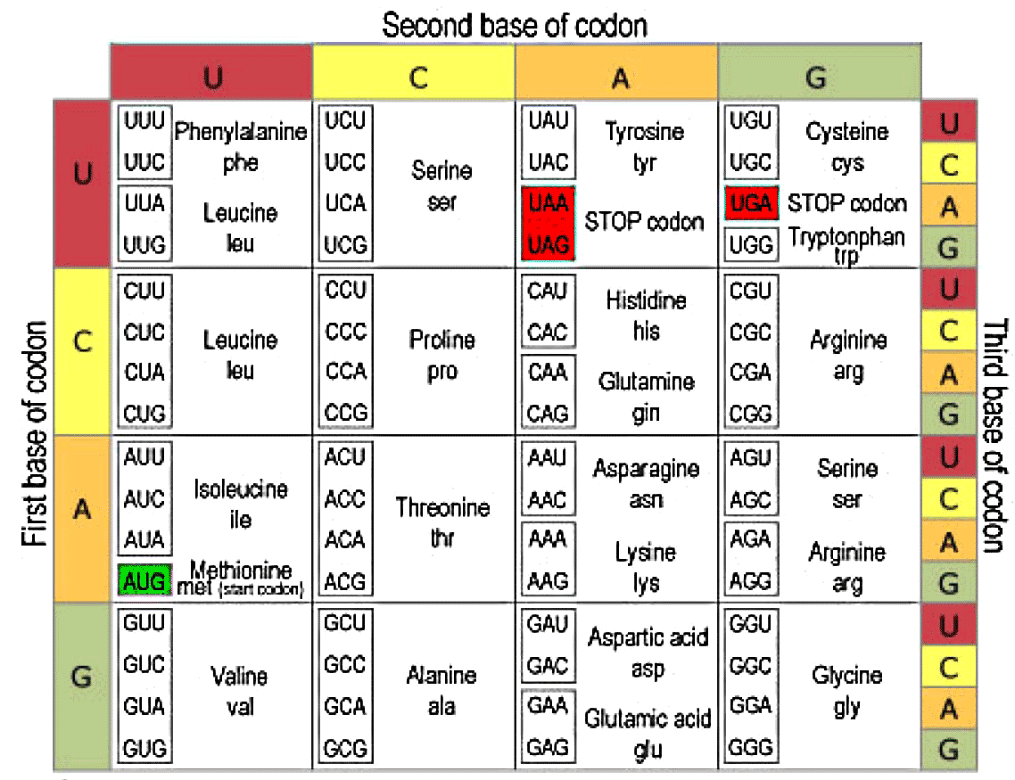
TASK
Use the look up table to create a DNA strand that will code for a 10 amino acid protein, it needs to start with Methionine and end with a stop code
Swap with the person next to you
Convert their DNA strand into a polypeptide chain

Slide 15
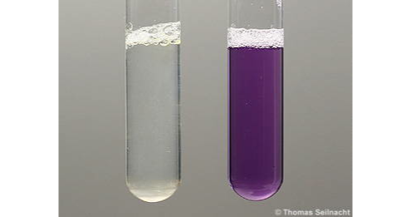
Protein (biuret test)
- Describe the test for protein
Add sample to a test tube.
Add biuret reagent
Positive result shown by lilac

Slide 16
PAST Paper Question
- Describe the structure of an amino acid
- Describe the formation and breakage of peptide bonds
- Explain the term primary structure
- Describe the test for protein
Jan 2010 Q4a

Slide 17
[3]

Slide 18
PAST Paper Question
- Describe the structure of an amino acid
- Describe the formation and breakage of peptide bonds
- Explain the term primary structure
- Describe the test for protein

Slide 19
Practical Activity 21
- Describe the test for protein
Draw a results table for Practical activity 21
Carry out Biuret and Emulsion test to identify samples
You will need in your lab book:
Results tables for both tests
Photos of both tests
PAG9
Practical Skills:
Drawing Results Table

Slide 20
Peer Assess Results Table
Mark | Complete?
Appropriate column and row headings
Ruled rows and columns
Separate conclusions and observation columns
All tests and results recorded
Correct conclusions for all test results

Slide 21
Plenary
- Describe the structure of an amino acid
- Describe the formation and breakage of peptide bonds
Draw the structure of a protein and label it in as much detail as you can

Slide 22
ANSWERS
Amine group R group Acid group

Slide 23
Homework
Complete the first part of the summary table

