Slide 1
Proteins: Secondary and Tertiary Structure

Slide 2
Need TO Book
Plasticene
OHP, OHT, OHT pens
Textbooks
Repro:
  Sources
  Flipped learning task (in folder lesson 8) to set as homework

Slide 3
Success Criteria
Learning Objective
Know about protein structure
Explain the term secondary structure
  Including hydrogen bonds
Explain the term tertiary structure
  Including hydrophobic and hydrophilic interactions, disulfide bonds and ionic bonds

Slide 4
Starter
Draw the structure of a protein and label it in as much detail as you can

Slide 5
Key Term: Secondary Structure
- Explain the term secondary structure
The coiling and pleating of parts of the polypeptide molecule

Slide 6
Secondary Structures
- Explain the term secondary structure
Alpha Helix or Beta Pleated Sheet
Hydrogen bonds hold the structure in place
Hydrogen bonds form between oxygen and hydrogen atoms
Although hydrogen bonds are quite weak, as many bonds are formed they add stability to the structure of the protein

Slide 7

Alpha Helix
- Explain the term secondary structure
Right hand coil, where hydrogen bonds form between oxygen and hydrogen atoms bought into close proximity
Stabilises the protein
HYDROGEN
BOND
Alpha helix

Slide 8
Beta Pleated Sheet
- Explain the term secondary structure
Amino acid chain folds up on itself forming anti-parallel chains
O and H atoms bought in close proximity to each other form hydrogen bonds
Stabilises the protein
Beta pleated sheet

Slide 9
Task
- Explain the term secondary structure
Make plasticene models of alpha helix and beta pleated sheet
Describe the structures to the person next to you

Slide 10
Key Term: Tertiary Structure
- Explain the term tertiary structure
The overall 3D structure of the protein molecule
Caused by R groups attracting or repelling

Slide 11
Tertiary Structure
- Explain the term tertiary structure
The final 3D shape of the protein is formed when the polypeptide chain with the coils and pleats fold themselves
The 3D shape is held in place by
  Hydrophobic and hydrophilic interactions
  Disulphide bonds
  Ionic interactions
  Hydrogen bonds

Slide 12
TasK
Describe what is meant by the following:
  Tertiary structure
  Hydrophobic and hydrophilic interactions
  Disulfide bonds
  Ionic interactions
  Hydrogen bonds

Slide 13
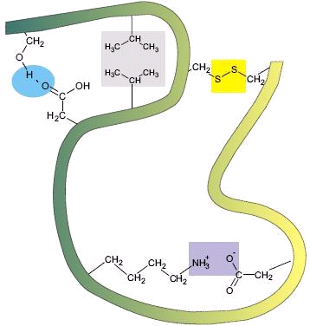
Tertiary structure
Hydrophobic amino acids will orientate towards the centre of the polypeptide to avoid contact with water, while hydrophilic amino acids will orientate themselves outwards

Slide 14
Tertiary structure
The R-group of cystine can form a covalent bond with the R-group of another cystine forming a disulphide bridge.

Slide 15
Tertiary structure
Positively charged R-groups will interact with negatively charged R-groups – ionic bonds

Slide 16
Tertiary structure
Polar R-groups will forms hydrogen bonds with other polar R-groups

Slide 17
Tertiary Structure
- Explain the term tertiary structure
The proteins shape is vital to each function
Three examples are
  Enzyme
  Hormone Receptor
  Collagen
  Why is shape important in these three cases?

Slide 18
Answers
- Explain the term tertiary structure
Enzyme: fit of the active site to its specific substrate
Hormone receptor: hormone won’t bind unless specific shape
Collagen: shaped for strength

Slide 19
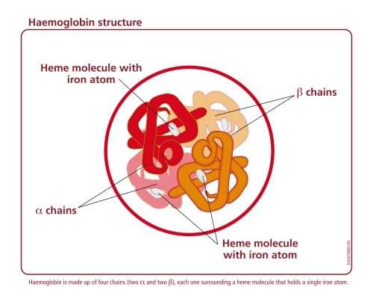
Quaternary structure
This is the linking together of 2 or more polypeptides to form a single protein.
Haemoglobin has a quaternary structure. It is composed of four different polypeptide chains.

Slide 20
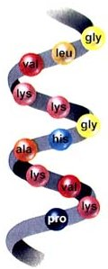
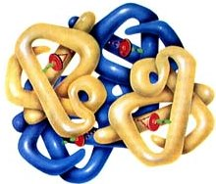
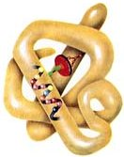
Levels of protein structure
- Explain the term tertiary structure
Primary
Secondary
Quaternary
Tertiary

Slide 21
3D Protein Shapes
- Explain the term tertiary structure
Globular
  Ball structure
  Hydrophobic amino acids turn inwards and hydrophilic interactions turn outwards making them water soluble
  E.g. enzymes
Fibrous
  Form fibres
  Regular repetitive amino acid sequences
  Usually insoluble
  E.g. collagen

Slide 22
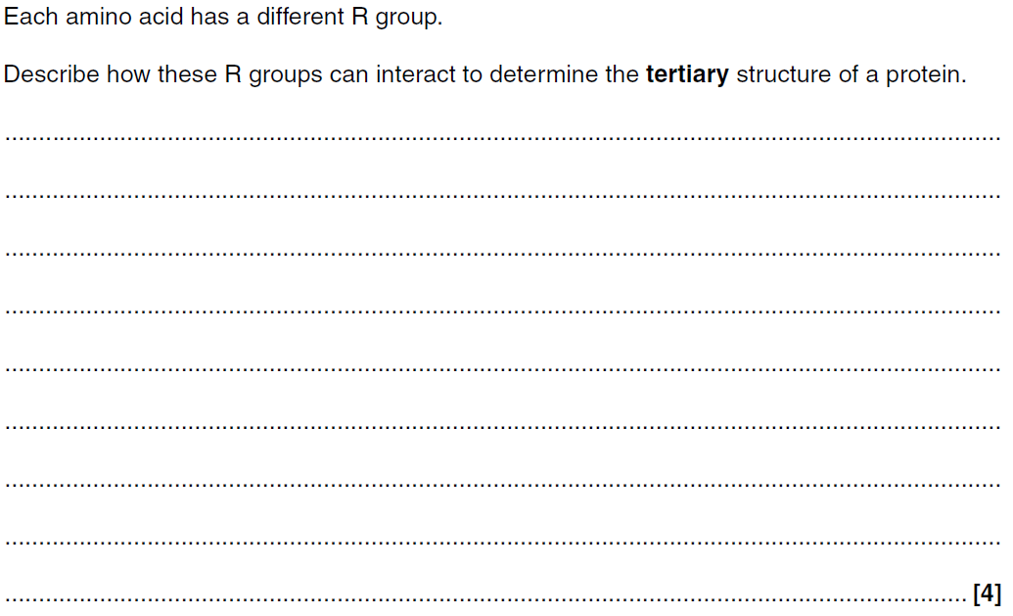
Plenary: PPQ
- Explain the term tertiary structure

Slide 23
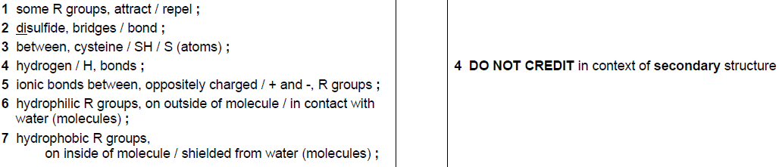
Markscheme
- Explain the term tertiary structure

Slide 24
Extension
Draw the structure of a protein and label it in as much detail as you can

Slide 25
Homework
Flipped Learning Task
Complete the next part of the summary table

