Slide 1
Proximal Convoluted Tubule

Slide 2
Spec
(c) (i) the structure, mechanisms of action and functions of the mammalian kidney (ii) the dissection, examination and drawing of the external and internal structure of the kidney (iii) the examination and drawing of stained sections to show the histology of nephrons
To include the gross structure and histology of the kidney including the detailed structure of a nephron and its associated blood vessels AND the processes of ultrafiltration, selective reabsorption and the production of urine. PAG1, PAG2

Slide 3
Learning Objective
To know about the PCT
Describe the process of selective reabsorption in the production of urine
Success Criteria

Slide 4
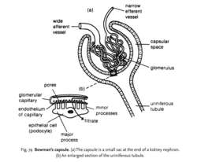
Starter
Challenge: What is missing?
Notes:
Clockwise from 12 o’clock: Efferent arteriole, Bowman’s capsule, glomerulus, major processes, podocyte, capillary endothelium (as flat, epithelium if square), afferent arteriole
Missing: Basement membrane

Slide 5
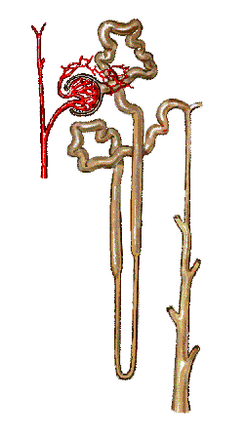
The PCT
Proximal Convoluted Tubule – the first section of kidney tubule after the Bowman’s Capsule!

Slide 6
Selective Reabsorption
Most reabsorption occurs in the proximal convoluted tubule (~85% filtrate)
Cells specialised in PCT for reabsorption:
Microvilli for increased surface area
Co-transporter proteins to transport glucose or amino acids (by facilitated diffusion)
Sodium-potassium pumps
Cytoplasm containing lots of mitochondria
See Figure 2 on page 33 of textbook

Slide 7
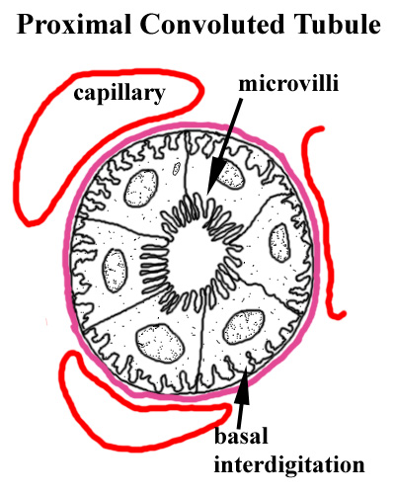
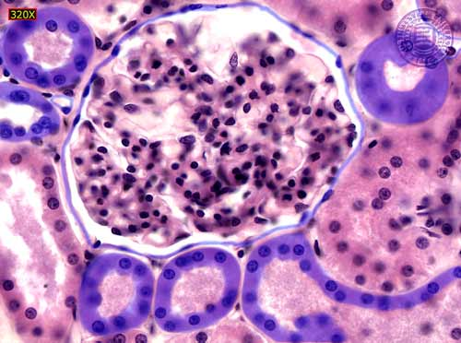
Structure of the PCT
Cells of the PCT have microvilli on the inside which increase surface area and improve efficiency of selective reabsorption…

Slide 8
Selective Reabsorption 2
Sodium-potassium pumps remove sodium ions from cells lining PCT and into blood (to lower conc. of Na in the cells)
Sodium ions + glucose or amino acids transported into cells lining PCT from PCT lumen by facilitated diffusion
As concentrations of glucose or amino acids rise in tissues, they move by diffusion into blood
Reabsorption of glucose and amino acids reduces water potential in cell so water enters cells and then reabsorbed into blood by osmosis
Larger molecules reabsorbed by endocytosis

Slide 9
Activity
Copy the diagram below and sketch the movement of molecules in as much detail as you can OR model it using playdoh

Slide 10
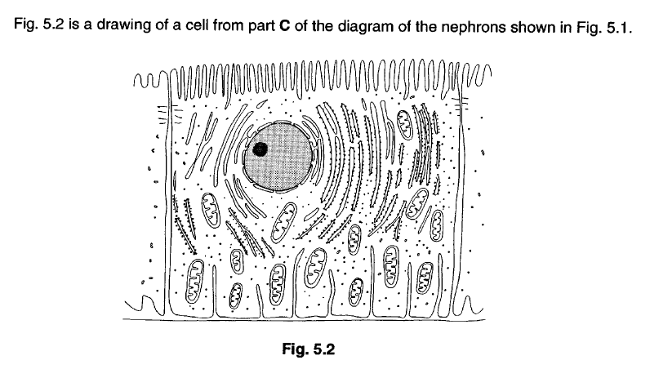
PAST PAPER QUESTION

Slide 13
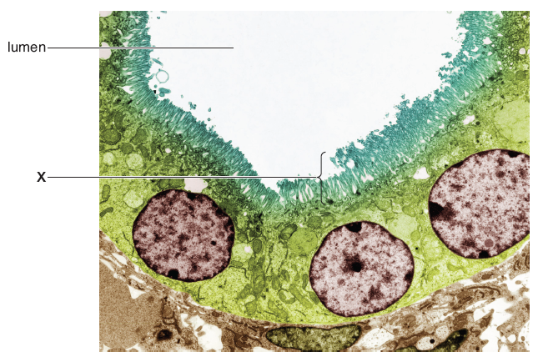

Slide 14
Markscheme

Slide 15
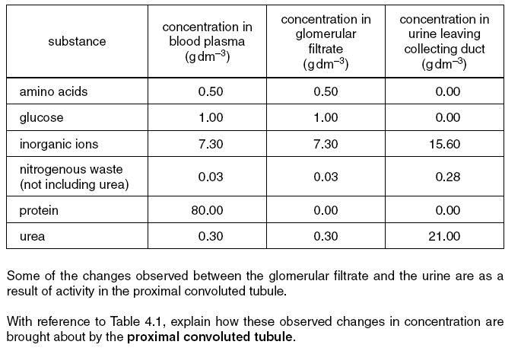
Includes QWC [4]
QWC [3]

Slide 16
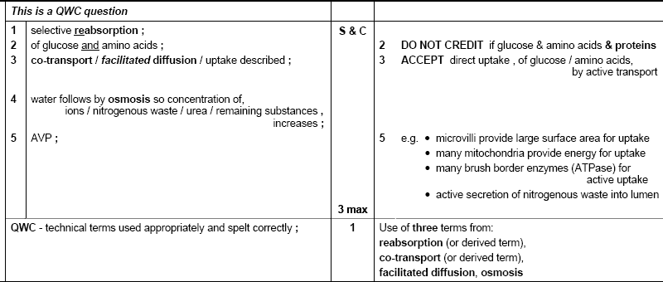
Markscheme

Slide 17
Extension
Answer questions 1-3 on page 45
Stretch and Challenge

