Slide 1
Muscle contraction, hox genes, respiration & translocation

Slide 2
Hox Genes

Slide 3
Hox Genes Definitions
Homeobox gene sequences
About 180bp sequence found WITHIN genes
Highly conserved regions
Hox genes
Group of genes that control body plan
Determine type of segment structure in embryo development e.g. leg, antennae

Slide 4
Muscle Contraction

Slide 5
Muscles
Cardiac:
Muscle tissue in heart
Smooth or involuntary:
These are controlled by the autonomic nervous system. E.g. smooth muscle in gut, blood vessels etc.
Striated or skeletal:
These muscles are under conscious control. Often attached to bone and enable movements e.g. biceps, tongue etc.

Slide 6
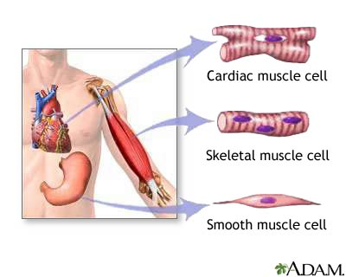
Types of Muscle
Skeletal muscle (striated, voluntary, striped)
This is always attached to the skeleton, and is under voluntary control via the motor neurones of the somatic nervous system. It can be subdivided into red (slow) muscle and white (fast) muscle.
Cardiac Muscle
This is a special type of red skeletal muscle. It looks and works much like skeletal muscle, but is not attached to skeleton, and is not under voluntary control.
Smooth Muscle
This is found in internal body organs such as the wall of the gut, the uterus, blood arteries, the iris, and glandular ducts. It is under involuntary control via the autonomic nervous system or hormones. Smooth muscle usually forms a ring, which tightens when it contracts, so there is no need of a skeleton to pull against.

Slide 7
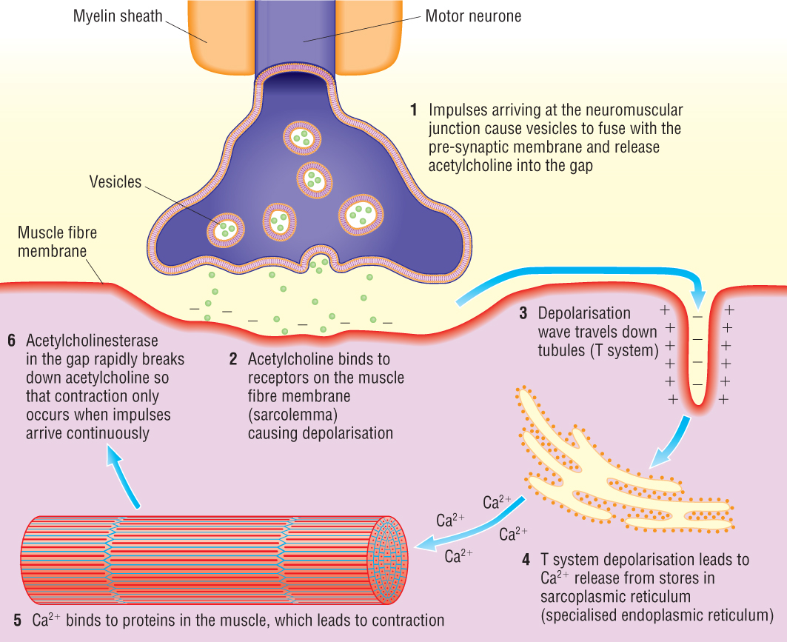
Neuromuscular Junction

Slide 8
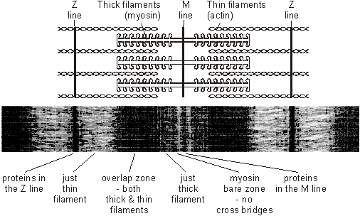

Slide 9
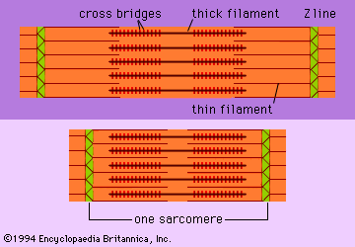
Thin filaments are composed of actin (and associated proteins).
Thick filaments are composed of myosin
The size of the different zones/bands changes when a myofibril is contracting e.g. the H zone disappears. The Z lines move closer together as the sarcomere shortens (contracts)

Slide 10
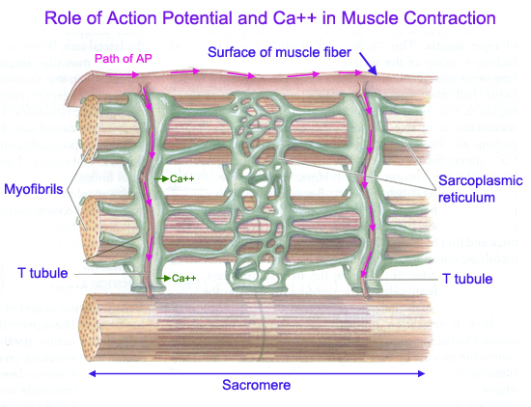
1
An action potential arriving at a motor end plate causes the release of acetylcholine into the plasma membrane of the muscle fibre (called the sarcolemma). This depolarises the sarcolemma and a wave of depolarisation spreads over the sarcolemma and into the muscle fibre via infoldings (called T tubules). This depolarisation causes the release of calcium ions from the sarcoplasmic reticulum (similar to endoplasmic reticulum).

Slide 11
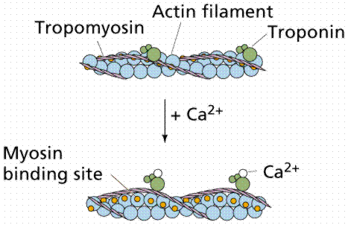
2
The calcium ions attach to the troponin complexes and cause them to detach from tropomyosin. This exposes myosin binding sites.

Slide 12
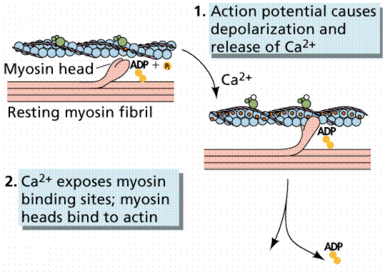
3
As the myosin attaches to the actin, a molecule of ATP is broken down into ADP and Pi. This release of energy provides the energy for the contraction or power stroke

Slide 13
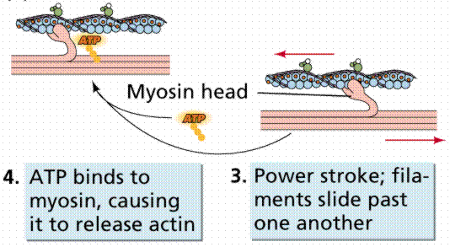
4
Myosin, locked onto actin, now contracts – pulling the actin filaments. The 2 filaments slide past each other – this is why it is called the sliding filament model of muscle contraction

Slide 14
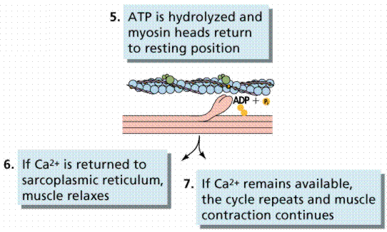
5
A molecule of ATP is utilized – this causes the release of the myosin head from the actin.
The filaments relax.
6
7
Note – if no new ATP is available, the myosin cannot release and the muscle would stay contracted. This is what happens in the state of rigor mortis

Slide 15
Maintaining ATP supply
2. Anaerobic respiration.
Produces lactate and can lead to fatigue/cramp.
Aerobic respiration in muscle cells.
Needs a supply of respiratory substrate and oxygen
3. Creatinine phosphate – another chemical present in muscle cells can donate its phosphate to recharge ADP back to ATP

Slide 16
Translocation

Slide 17
Translocation
Define key terms: source, sink & translocation (Grade E-D)
Definition:
Transport of assimilates throughout the plant, in the phloem tissue

Slide 18
Source & Sink
State examples of source and sinks (Grade E-D)
Define key terms: source, sink & translocation (Grade E-D)
What is a source?
Examples:
Leaf Cell
What is a sink?
Examples:
Root Cell
Notes:
Leaf cell can be both as can root cell. Leaf sink when growing, source when photosynthesising, root cell can be source as over winter some roots used to store sugars for spring

Slide 19
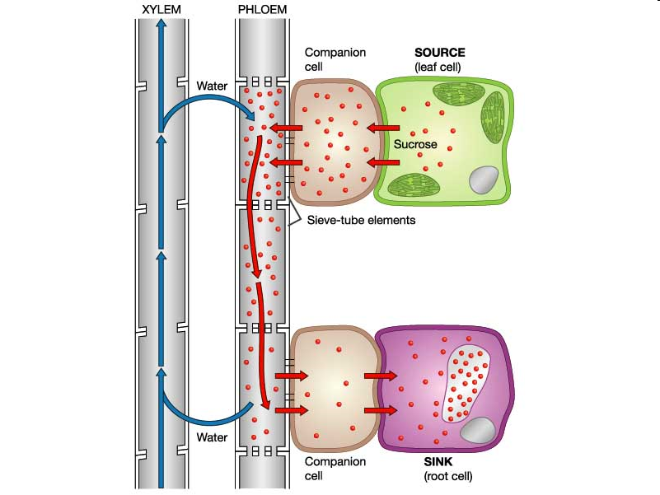
Active Loading at the Source
Interpret the mechanism of active loading (Grade C-A)
Companion cells
Have lots of mitochondria to make ATP
ATP used to pump out protons (H⁺ ions)
This causes a diffusion gradient
Protons diffuse back in through cotransporter proteins, bringing sucrose in with them
This leads to a high concentration of sucrose
Sieve Tube Elements
Sucrose moves in through plasmodesmata
Sucrose lowers the water potential, so water moves in by osmosis
This increases the hydrostatic pressure

Slide 20
Removal at the Sink
Interpret the mechanism of active loading (Grade C-A)
Sink
Uses up sucrose in respiration or it is stored as starch
Lowers sucrose concentration
Sucrose moves in by diffusion, lowering the water potential
Water moves into the sink by osmosis
This lowers the hydrostatic pressure
This high hydrostatic pressure near the source and low hydrostatic pressure near the sink creates movement in the phloem called mass flow

Slide 21
OLD SPEC: Evidence
Evaluate evidence for this mechanism (Grade C-A)
Active loading and movement of sucrose in the phloem is a theory
Evidence supports this theory

Slide 22
Radioactive labelling of carbon dioxide (for photosynthesis)
Labelled carbon observed in the phloem
Movement of labelled sucrose is faster than it would be by diffusion
Sucrose is moved to all parts of the plant at the same rate, rather than going quicker to areas of low concentration

Slide 23
Tree Ringing
Removal of bark in a ring all around the tree trunk, which removes the phloem but leaves the xylem intact
Tree swells above the ring, where sugar collect
Mitochondria
Companion cells have large amounts of
mitochondria

Slide 24
Aphids
Feed by inserting mouth parts into phloem
Analysis of fluids collected from aphids contain lots of sugars
Companion Cells pH have a higher than surrounding cells
pH

Slide 25
Animal Responses
What did you mean? All the animal responses stuff in the spec is hormonal and nervous control

Slide 26
Respiration

Slide 27
Glycolysis
Glucose
ATP
Glucose-6-phosphate
Fructose-1-phosphate
ATP
Hexose-1,6-bisphosphate
Triose Phosphate Triose Phosphate
2 ATP & redNAD 2 ATP & redNAD
Pyruvate Pyruvate
Net Gain:
2 ATP
2 red NAD

Slide 28
Link Reaction
Pyruvate
red NAD
CoA
Carbon dioxide
Acetyl CoA
Net gain:
2 red NAD
2 Carbon Dioxide

Slide 29
Outline of Krebs Cycle
Net Gain:
6 red NAD
2 red FAD
4 carbon dioxide
2 ATP
Acetate
Oxaloacetate Citrate
CO₂
Red NAD Red NAD
5C Compound
CO₂
Red NAD
4C Compound 4C Compound
red FAD 4C Compound ATP

Slide 30
Oxidative Phosphorylation
Red NAD releases 2 H ions and 2 electrons (along ETC)
Red FAD releases 2 H ions (to join with ½ oxygen) and 2 electrons (along ETC)
Complex III & IV pump H ions into the intermembrance space
High concentration of H ions in the intermembrane space means they move by chemiosmosis through ATP synthase
ATP synthase uses the motive force to turn ADP back into ATP
½ Oxygen accepts the 2 H ions from red FAD and 4 electrons from the end of the ETC

Slide 31
Anaerobic Respiration
 | Yeast | Mammals
Hydrogen Acceptor | Ethanal | Pyruvate
Is carbon dioxide made? | Yes | No
Is ATP made? | No | No
Is NAD reoxidised? | Yes | Yes
End products | Ethanol & Carbon Dioxide | Lactate
Enzymes involved | Pyruvate decarboxylase & Ethanol Dehydrogenase | Lactate dehydrogenase

Slide 32
RQ

