Slide 1
STAR Time
Respond to feedback in purple pens, and carry out improvements to work
Make sure you have filled in your self-assessment part in purple pen, and recorded your results on your tracker sheet

Slide 2
Cholesterol Questions
Draw the structure of cholesterol.
Is cholesterol hydrophobic or hydrophilic?
What is the function of cholesterol in the phospholipid bilayer?
Why is it able to sit in the bilayer?
4. Where in animals is cholesterol made?
Hydrophobic
It regulates the fluidity of the membrane
Because it is hydrophobic, it is able to sit in the middle of the bilayer
Liver

Slide 3
 | Structure | Properties | Function
Triglycerides | Glycerol & 3 fatty acids | Compact Insoluble 38kJ/g | Energy Store Doesn’t affect water potential
Phospholipids | Glycerol, 2 fatty acids and a phosphate group | Part hydrophobic, part hydrophilic Less energy content as phosphate group can’t be used | Forms membranes
Cholesterol | 4 carbon based ring structures, hydroxyl group | Thin molecules Part hydrophobic, part hydrophilic. Alcohols can have a high energy content | Fit into the membrane giving strength and stability
Notes:
Glucose is 17kJ/g
Twice as much energy in 1g of fat as 1g of carbohydrate

Slide 4
Homework PPQs
a)
(b) phospholipids have
1 less fatty acid (residue) / 2 fatty acid (residues) not 3; A hydrocarbon 1 less ester bond / 2 ester bonds not 3; phosphate; choline / base / nitrogen; hydrophilic / polar, end / head;

Slide 5
Cellulose and Polysaccharides
Q: What type of monomers is cellulose made up of?
Β-glucose
Q: What arrangement do these monomers have when formed into a polymer?
Every other monomer is rotated 180⁰
Q: What is formed between the monomers in the polymer?
Hydrogen bonds and 1-4 glyosidic bonds

Slide 6
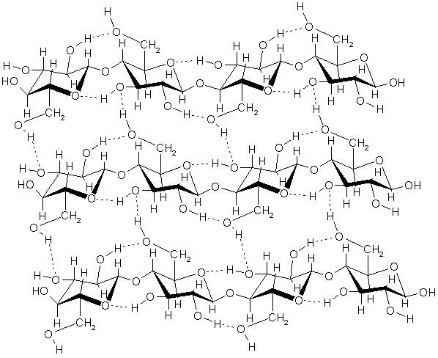
Cellulose and Polysaccharides
Beta glucose
Beta 1-4 glycosidic bonds (every other glucose inverted)
Parallel Chains
Lots of Hydrogen bonds form between the chains (strength)
Structural: Cell Wall
The β-glycosidic bond can only be broken down by a cellulose enzyme, which herbivores have, but humans do not
Chains grouped into microfibrils
Microfibrils grouped into fibres (strength)
The arrangement of macrofibrils in cell walls:
allows water to move through cell walls
allows water to move in and out of cells easily
prevents cells bursting when turgid
determines how a cell can grow or change shape
Cell walls can be reinforced with other substances to provide extra support, or make the walls waterproof

