Slide 1
Starch
Lesson 3

Slide 2
Need to book
Practical Activity 20
Repro
Question chase
Practical Activity sheet 20
Option to do some of learning as independent learning activity, sources in folder

Slide 3
Success Criteria
Learning Objective
Know about polysaccharides
Describe the structure of starch (amylose & amylopectin), glycogen and cellulose
Explain how the structure and properties of glucose, starch, glycogen and cellulose relate to their functions in living organisms
Describe how to carry out the non-reducing sugars test

Slide 4
Starter
In groups list 5 of any of the following
Bonds
Sugars
Monosaccharides
Disaccharides
Polysaccharides
Challenge: Can you name one of each?
Challenge: Can you names 3 of each?

Slide 5
GROUP TASK
Make an information sheet on carbohydrates to include the following:
Compare and contrast the structure and function of glucose, starch, cellulose and glycogen

Slide 6
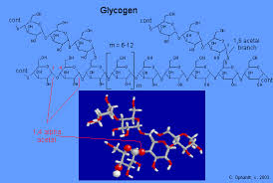
General Structure and Function OF Energy Stores
Carbohydrates as energy stores
E.g. Starch and Glycogen
Don’t dissolve
Don’t effect water potential
Branched molecules
Glucose can be easily broken off

Slide 7
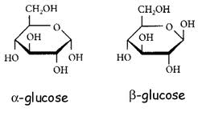
Properties of Glucose
- Explain how the structure and properties of glucose, starch, glycogen and cellulose relate to their functions in living organisms
Used in respiration (brain cannot use anything else) to release energy and cause the formation of ATP
Easily converted into glycogen for storage
Soluble in water, lowers water potential, causes osmotic problems.

Slide 8
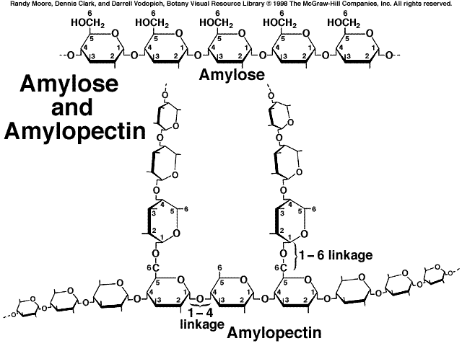
Structure of Starch
- Describe the structure of starch (amylose & amylopectin), glycogen and cellulose
- Explain how the structure and properties of glucose, starch, glycogen and
cellulose relate to their functions in living organisms
Two slightly different polysaccharides are known collectively as starch
Amylose
Amylopectin
Chemical energy store in plants

Slide 9
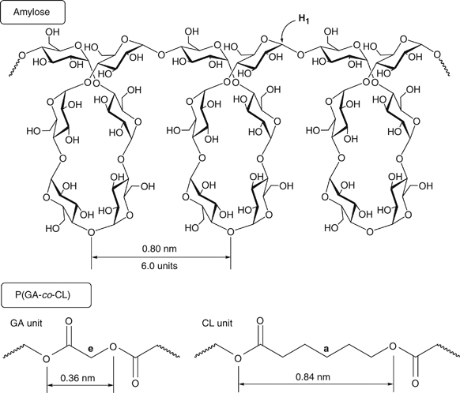
Structure of starch (AMYLOSE)
- Describe the structure of starch (amylose & amylopectin), glycogen and cellulose
- Explain how the structure and properties of glucose, starch, glycogen and cellulose relate to their functions in living organisms
Alpha Glucose
Alpha 1-4 glycosidic bonds
Long coiled chains (forms helix) so lots of stabilising H bonds
Less soluble
Compact
Insoluble in water so does not affect the water potential of the cell so excellent for storage.

Slide 10
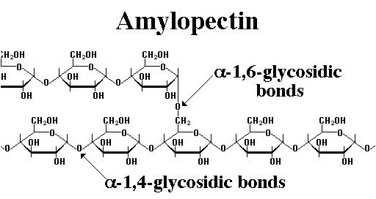
Structure of Starch (Amylopectin)
- Describe the structure of starch (amylose & amylopectin), glycogen and cellulose
- Explain how the structure and properties of glucose, starch, glycogen and cellulose relate to their functions in living organisms
1-4 glycosidic bonds and 1-6 glycosidic bonds
Branches every 25 subunits

Slide 11
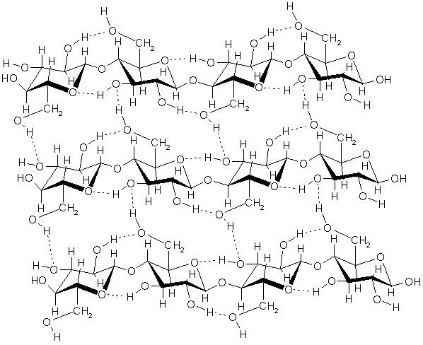
Structure of Cellulose
- Describe the structure of starch (amylose & amylopectin), glycogen and cellulose
- Explain how the structure and properties of glucose, starch, glycogen and cellulose relate to their functions in living organisms
Beta glucose
Beta 1-4 glycosidic bonds (every other glucose inverted)
Parallel Chains
Lots of Hydrogen bonds form between the chains (strength)
Structural: Cell Wall
The β-glycosidic bond can only be broken down by a cellulose enzyme, which herbivores have, but humans do not
Chains grouped into microfibrils
Microfibrils grouped into fibres (strength)
The arrangement of macrofibrils in cell walls:
allows water to move through cell walls
allows water to move in and out of cells easily
prevents cells bursting when turgid
determines how a cell can grow or change shape
Cell walls can be reinforced with other substances to provide extra support, or make the walls waterproof

Slide 12
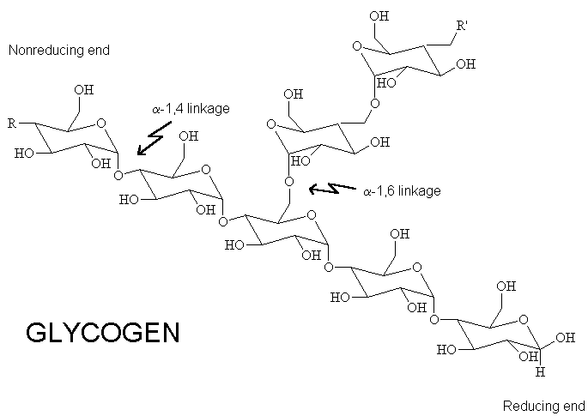
Structure of Glycogen
- Describe the structure of starch (amylose & amylopectin), glycogen and cellulose
- Explain how the structure and properties of glucose, starch, glycogen and cellulose relate to their functions in living organisms
Made up of α glucose
Joined by 1-4 glycosidic bonds and also 1-6 glycosidic bonds which form branches.
Forms granules
Highly branched so it can be hydrolysed into glucose very quickly due to lots of branches for enzymes to attach
Insoluble so does not affect the water potential of the cell
Compact molecule therefore high energy content for its mass

Slide 13
Practical Activity 20
Describe how to carry out the non-reducing sugars test
Non-reducing sugars test
In your lab book you will need:
Results table
Photos of results
PAG 9

Slide 14
Plenary: Question Chase
Describe the structure of starch (amylose &
amylopectin), glycogen and cellulose
Explain how the structure and properties of glucose, starch, glycogen and cellulose relate to their functions in living organisms
Describe how to carry out the non-reducing sugars test

