Slide 1
12a2 Revision

Slide 2
Tissue Fluid Formation

Slide 3
What is meant by these three key terms?
Blood
Tissue Fluid
Lymph

Slide 4
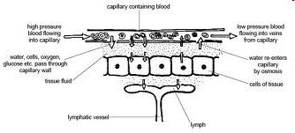
Tissue Fluid Formation

Slide 5
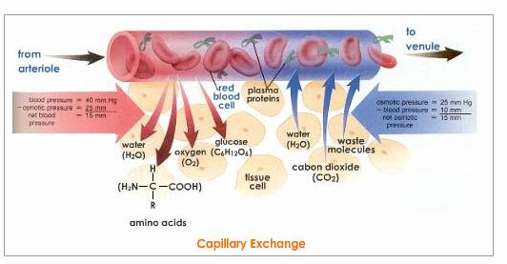
Tissue Fluid Formation
Capillaries are narrower than other blood vessels creating hydrostatic pressure causing ultrafiltration

Slide 6
Tissue Fluid Formation
Exchange of metabolic materials with cells

Slide 7
Tissue Fluid Formation
Tissue fluid moves back into capillary as lower hydrostatic pressure in the capillary

Slide 8
Tissue Fluid Formation
Lower water potential in capillary so water moves back in by osmosis

Slide 9
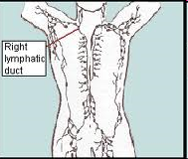
Lymph Formation
Not all tissue fluid returns to capillaries, some is drained into the lymphatic system.
Lymph has
less oxygen and nutrients than tissue fluid
more carbon dioxide
more fatty material absorbed from the intestines.
presence of lymphocytes produced in lymph nodes

Slide 10
Bohr Shift

Slide 11
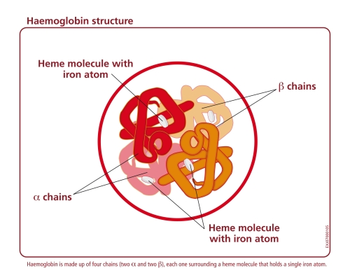
Haemoglobin
Protein
2 alpha chains
2 beta chains
Each with haem group to bind to oxygen molecule

Slide 12
Carbon Dioxide
Released by respiring cells
Some dissolved in plasma, some combines with Hb
Carbon dioxide will reduce Hb’s affinity for oxygen, so Hb will release oxygen where it is needed

Slide 13
Bohr Effect
CO₂ + H₂O → H₂CO₃→ H⁺ + HCO₃⁻
carbonic acid → hydrogen ions + hydrogen carbonate ions
Caused by enzyme carbonic anhydrase in RBCs
Hb + H⁺ → Haemoglobinic acid
H⁺ cause acidity that promotes oxygen release

Slide 14
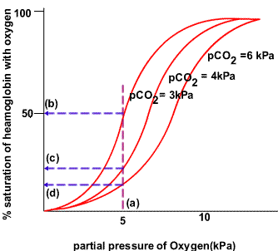
Bohr Effect: Oxygen Dissociation Curve shifts to right

Slide 15
Transpiration

Slide 16
Transpiration
The loss of water vapour from aerial parts of a plant due to evaporation

Slide 17
Transpiration
Movement of water from the roots, up the stem and out of the leaves
Push: by water moving into the roots
Pull: by evaporation from the leaves
Water evaporates from internal surfaces of the leaves and collects in the air spaces, when the concentration of water is higher inside the leaf than out the water moves out of the stomata by osmosis

Slide 18
Factor | How to increase water loss
Number of leaves | More surface area
Number, size & position of stomata | More, bigger and on under surface
Cuticle | Absent
Light | Present
Temperature | Higher
Humidity | Lower
Air movement | Fast
Water availability | Lots

Slide 19
Translocation

Slide 20
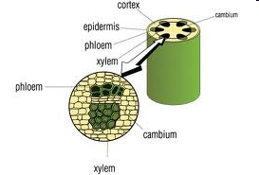
Translocation
Define key terms: source, sink & translocation (Grade E-D)
Definition:
Transport of assimilates throughout the plant, in the phloem tissue

Slide 21
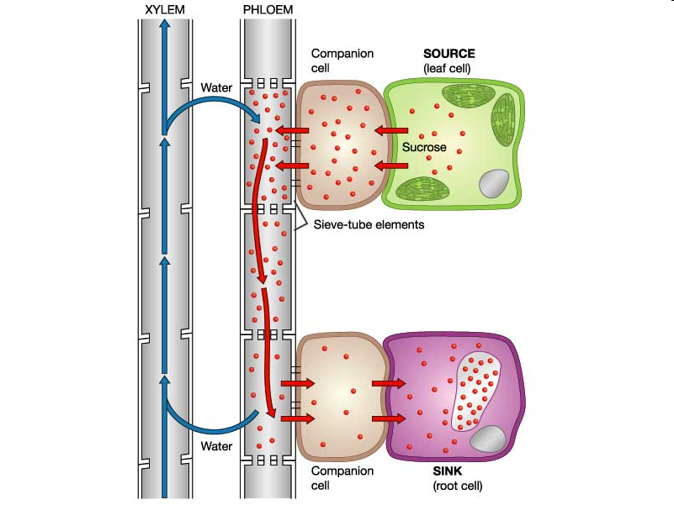
Source & Sink
State examples of source and sinks (Grade E-D)
Define key terms: source, sink & translocation (Grade E-D)
What is a source?
Examples:
Leaf Cell
What is a sink?
Examples:
Root Cell
Notes:
Leaf cell can be both as can root cell. Leaf sink when growing, source when photosynthesising, root cell can be source as over winter some roots used to store sugars for spring

Slide 22
Active Loading at the Source
Interpret the mechanism of active loading (Grade C-A)
Companion cells
Have lots of mitochondria to make ATP
ATP used to pump out protons (H⁺ ions)
This causes a diffusion gradient
Protons diffuse back in through cotransporter proteins, bringing sucrose in with them
This leads to a high concentration of sucrose
Sieve Tube Elements
Sucrose moves in through plasmodesmata
Sucrose lowers the water potential, so water moves in by osmosis
This increases the hydrostatic pressure

Slide 23
Removal at the Sink
Interpret the mechanism of active loading (Grade C-A)
Sink
Uses up sucrose in respiration or it is stored as starch
Lowers sucrose concentration
Sucrose moves in by diffusion, lowering the water potential
Water moves into the sink by osmosis
This lowers the hydrostatic pressure
This high hydrostatic pressure near the source and low hydrostatic pressure near the sink creates movement in the phloem called mass flow

Slide 24
Evidence
Evaluate evidence for this mechanism (Grade C-A)
Active loading and movement of sucrose in the phloem is a theory
Evidence supports this theory

Slide 25
Radioactive labelling of carbon dioxide (for photosynthesis)
Labelled carbon observed in the phloem
Movement of labelled sucrose is faster than it would be by diffusion
Sucrose is moved to all parts of the plant at the same rate, rather than going quicker to areas of low concentration

Slide 26
Tree Ringing
Removal of bark in a ring all around the tree trunk, which removes the phloem but leaves the xylem intact
Tree swells above the ring, where sugar collect
Mitochondria
Companion cells have large amounts of
mitochondria

Slide 27
Aphids
Feed by inserting mouth parts into phloem
Analysis of fluids collected from aphids contain lots of sugars
Companion Cells pH have a higher than surrounding cells
pH

