Slide 1
Water
Lesson 8

Slide 2
Need to Book
Molymods: H & O only (each pair needs 10 h and 5 O, 10 single bonds)
Mini whiteboards
A3 plain
Speakers
Could book a computer room
Repro:
Standard homework & feedback sheet
Video question sheet

Slide 3
Learning OBjective
Know about the properties and bonding of water
Describe how hydrogen bonding occurs between water molecules
Relate this, and other properties of water, to the roles of water in living organisms
Success Criteria

Slide 4
Starter
- Describe how hydrogen bonding occurs between water molecules
- Relate this, and other properties of water, to the roles of water in living organisms
Write down one thing about water
Pass it on
Add to the one in front of you
Repeat

Slide 5
Water
The nuclei of oxygen is significantly larger and greater charge (+8) than the hydrogen nuclei (+1).
Consequently the electron pair in the covalent bond is found 'closer' to the oxygen than the hydrogen nuclei.
This creates a polar molecule in which the oxygen carries and additional small negative dipole and each hydrogen a small positive dipole.

Slide 6
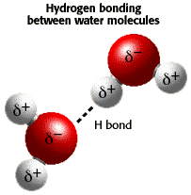
Hydrogen bonds
The oxygen atoms are attracted the hydrogen atoms of other molecules.
These attractions are called HYDROGEN BONDS.
The term ‘bond’ is misleading because:
It is an interaction between molecules not a bond within a molecule .
It does not change the chemical properties but accounts for physical properties.
It is significantly weaker than a covalent or an ionic bond.

Slide 7
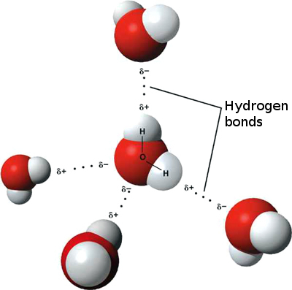
Hydrogen bonds
A single hydrogen bond is not very strong.
A large number of hydrogen bonds is very strong
Each water molecule bonds with 4 others in a tetrahedral arrangement.

Slide 8
Water Bonding
- Describe how hydrogen bonding occurs between water molecules
Draw and label a diagram showing the structure of water molecules to show their polarity and hydrogen bond formation

Slide 9
TasK: Video clip
- Describe how hydrogen bonding occurs between water molecules
- Relate this, and other properties of water, to the roles of water in living organisms
http://www.youtube.com/watch?v=HVT3Y3_gHGg
Watch the clip and answer the questions

Slide 10
Task
- Relate this, and other properties of water, to the roles of water in living organisms
Using video notes and textbooks
Make a mind map of properties and role of water in living organisms

Slide 11
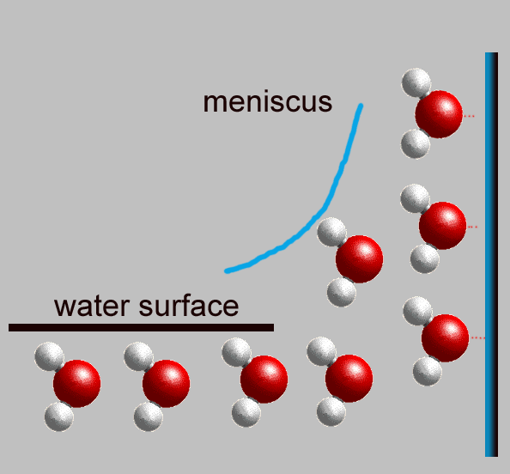
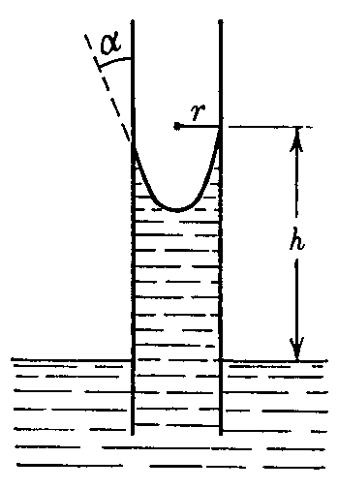
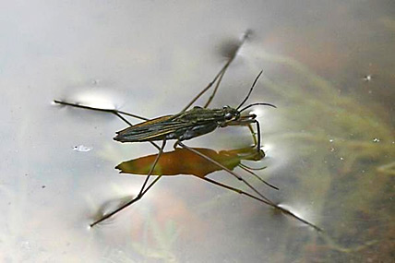
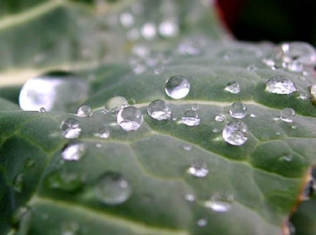
Cohesive/adhesive
Because of these hydrogen bonds water is cohesive : water molecules will stick to each other.
Water is also adhesive : it will stick to other surfaces
These properties lead to
Capillary action
Surface tension

Slide 12
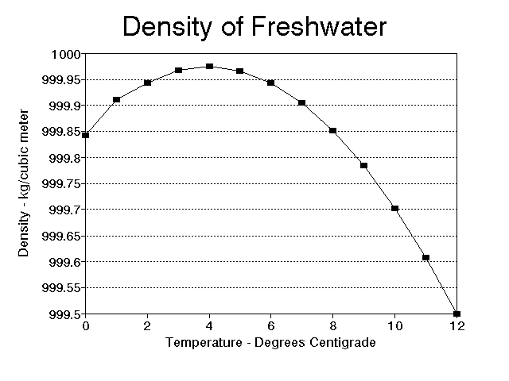
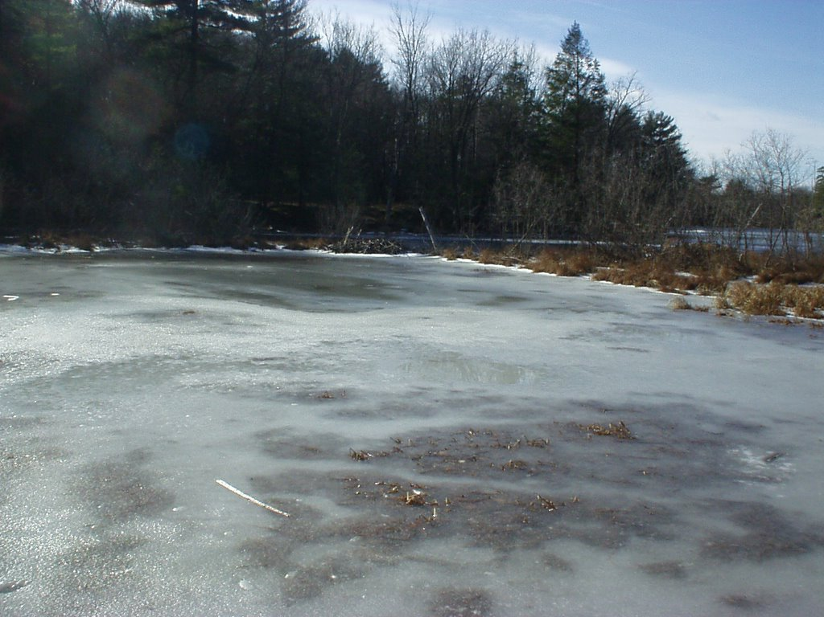
Density
Water is most dense at 4ºC and as a result ice float
This provides protection for aquatic organisms under the ice in lakes

Slide 13
Solvent properties
Water is a good solvent because it is a polar molecule.
It will dissolve polar solutes easily.
Water is a medium for metabolic reactions (reactions in living things) – the reactants are dissolved.
Water is a transport medium - it can transport molecules across membranes, as well as within or between cells.

Slide 14
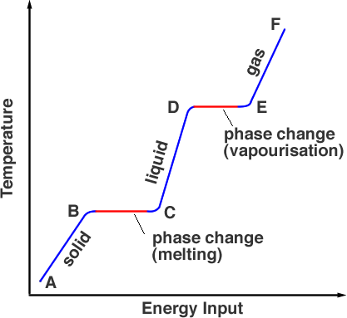
Thermal properties
Water has a high specific heat capacity, this means it takes a lot of energy for the temperature of water to change.

Slide 15
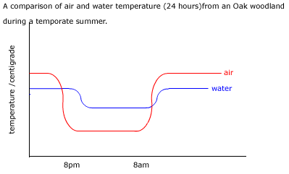
Thermal properties
The temperature of water remains relatively stable
Most organisms are adapted to a narrow range of conditions. The slow heating and cooling of water are ideal for these organisms.

Slide 16
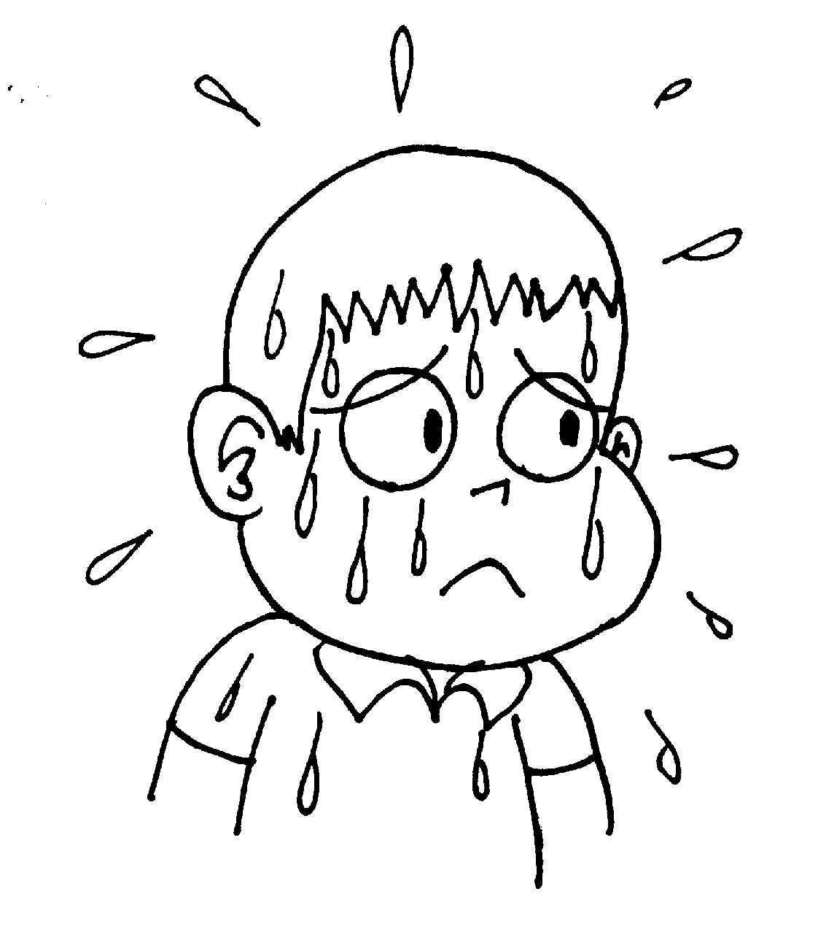
Thermal properties - coolant
Water can evaporate at temperatures below boiling point. Hydrogen bonds have to be broken to do this.
The heat energy needed to break the bonds is taken from the liquid, cooling it down.
Evaporation of water from plant leaves (transpiration) and from human skin (sweat) is a useful cooling effect.

Slide 17
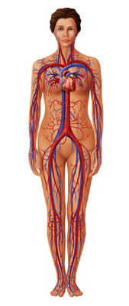
Thermal properties
The heat generated by the body needs to be removed to prevent a denaturation of enzyme systems.
Water absorbed a great deal of energy before entering the vapour phase. This makes it an effective agent for the removal of heat and the maintenance of body temperature.
Blood which is mainly water can absorb and carry heat away from hot parts of the body to the cooler parts.

Slide 20
Describe the importance of water to living organisms 6 marks
Peer assessment
Each feature or property must be related to living organisms in order to receive a mark.
surface tension – allows some organisms (eg insects) to move on water’s surface;
polarity / capillarity / adhesion – helps plants transport water;
transparency – allows plants to photosynthesise in water / allows animals to see;
(excellent) solvent – capable of dissolving substances for transport in organisms;
(excellent) thermal properties (high heat of vaporization) – excellent coolant; ice floats – lakes / oceans do not freeze, allowing life under the ice;
buoyancy – supports organisms;
structure – turgor in plant cells / hydrostatic skeleton;
habitat – place for aquatic organisms to live;
involved in chemical reactions in organisms; 6 max

Slide 21
Plenary Questions
Explain how hydrogen bonds form [3]
Suggest, with reasons, which properties of water make is such an important component of blood [3]

Slide 22
Markscheme
Oxygen and hydrogen share electrons unequally when they bond [1]; Oxygen is more negative & hydrogen is more positive [1]; More negative atom is attracted to the more positive atom [1]
Liquid so a good transport medium [1]; solvent so can transport polar substances [1]; coolant so resistant to temperature change [1]

Slide 23
Homework
- Describe how hydrogen bonding occurs between water molecules
- Relate this, and other properties of water, to the roles of water in living organisms
Standard Assessed Piece Homework

