Slide 1
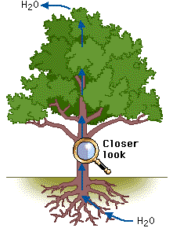
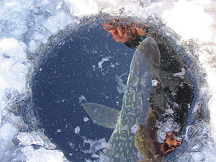
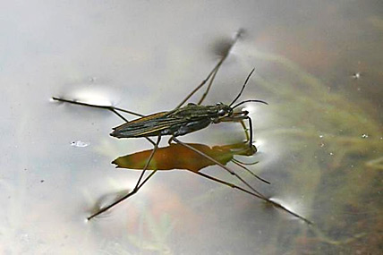
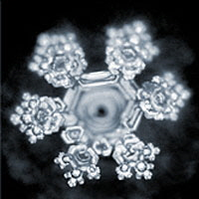
Water What do you know about its… Structure? Properties?

Slide 2
Properties of Water
Learning objective
To know about the properties and bonding of water
Success Criteria
Describe how hydrogen bonding occurs between water molecules
Relate this, and other properties of water, to the roles of water in living organisms

Slide 3
Polar molecule
Lots of hydrogen bonds
Cohesive
Properties of water
Cohesive
Solvent
Reactant
Thermally stable High specific heat capacity
High latent heat of evaporation
Liquid at room temp (and up to100 ºC) (liquid at higher temper
Solid (Ice) is less dense than liquid water (floats)

Slide 4
What are the properties of water?
Cohesive
Solvent
Reactant
High specific heat capacity
High latent heat of evaporation
Liquid
Floats

Slide 5
- Describe how hydrogen bonding occurs between water molecules
Water Bonding

Slide 6
Water Bonding
- Describe how hydrogen bonding occurs between water molecules
Covalent bonds form between oxygen and hydrogen in a water molecule
Unequal sharing of the electrons leads to oxygen being more negative compared with hydrogen
These are known as polar covalent bonds
Polar molecules have slightly positive and slightly negative regions which means they can form hydrogen bonds with each other
Hydrogen bonds are relatively weak interactions
Notes:
Lots weak H bond interactions, but together make it very strong

Slide 7
Water – an unusual molecule that we owe our entire existence to!
Compared to other similar molecules
Polar molecule
Forms lots of hydrogen bonds with other water molecules
Cohesive
Cohesion
The attraction of water molecules to each other due to hydrogen bonds

Slide 8
Reactant
Water is a reactant in chemical reactions such as photosynthesis, and in hydrolysis reactions such as digestion of starch, proteins and lipids etc
Solvent
The negative and positive parts of a water molecule are attracted to the negative and positive parts of the solute
The water molecules cluster around the charged parts of the solute, separating them, and forming a solution

Slide 9
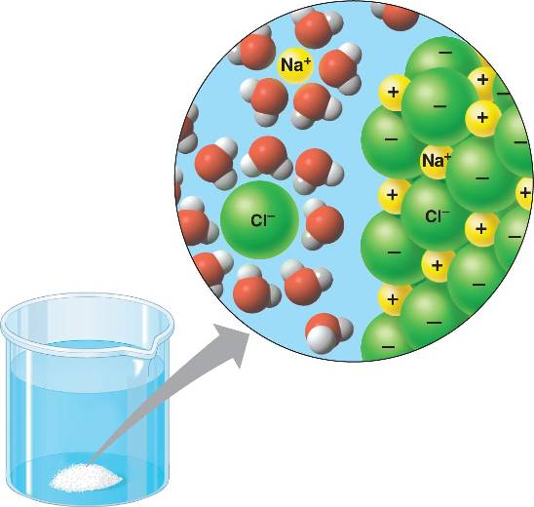

Slide 10
High specific heat capacity
This is the amount of energy required tp raise the temperature of 1kg of water by 1ºC
Lots of energy input is required to break the H bonds between water molecules
Therefore water does not cool down or heat up easily, and provides a stable temperature environment
High latent heat of evaporation
For water to become a gas, the H bonds between molecules need to be broken
Lots of energy is needed to break these bonds
Water therefore helps to cool living organisms due to the transfer of heat energy away from the surface

Slide 11
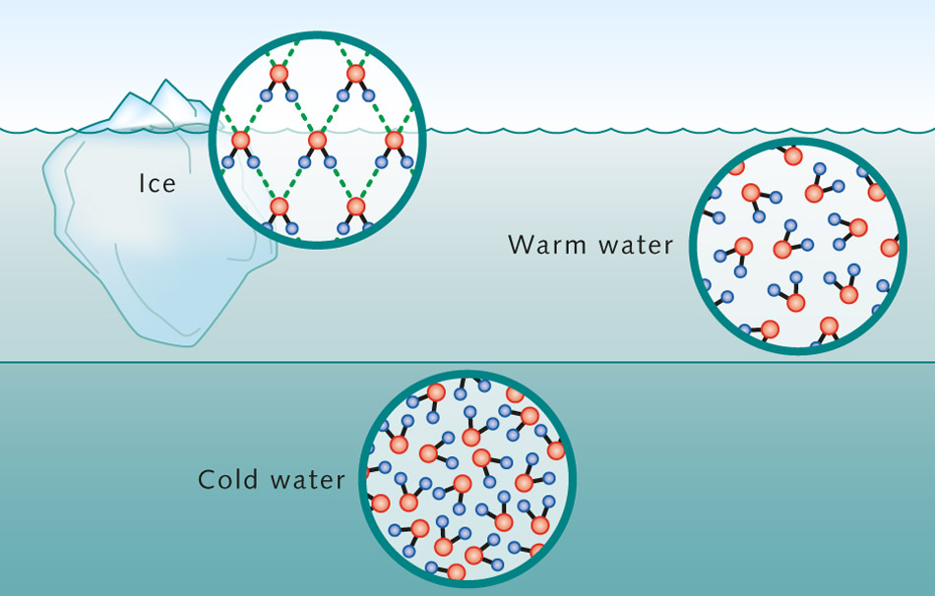

Slide 12
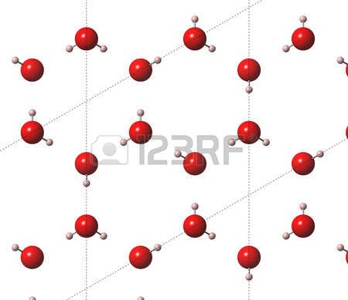

Slide 13
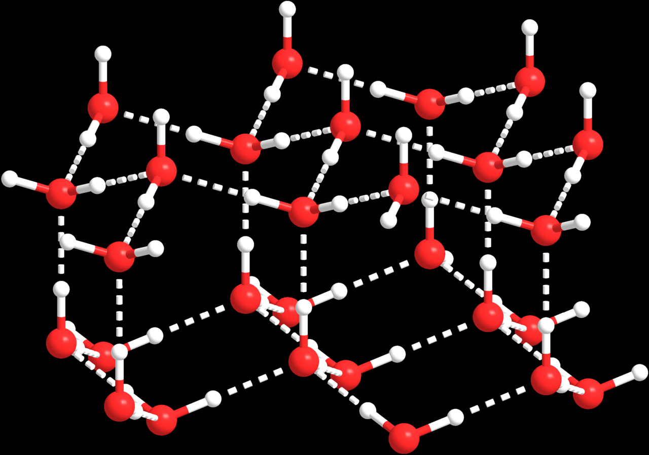
Ice

Slide 14
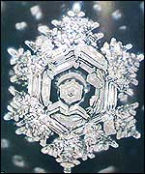

Slide 15
Task
- Relate this, and other properties of water, to the roles of water in living organisms
Using video notes and textbooks, own research
Make a mind map of properties and role of water in living organisms OR
Complete the summary table
Property of water | Why water has this property | How this property aids organisms on Earth (Prokaryotic and Eukaryotic)
Solid (Ice) is less dense than liquid water
Liquid at room temp (and up to 100 ºC)
Thermally stable High specific heat capacity
High latent heat of evaporation
Cohesive
Solvent
Reactant

Slide 16
Property of water | Why water has this property | How this property aids organisms on Earth (Prokaryotic and Eukaryotic)
Solid (Ice) is less dense than liquid water
Liquid at room temp (and up to 100 ºC)
Thermally stable High specific heat capacity
High latent heat of evaporation
Cohesive
Solvent
Reactant

Slide 17
Property of water | Why water has this property | How this property aids organisms on Earth P and E
Ice is less dense than water | Lower temp = more H bonds form These hold molecules further apart In a crystalline structure Water is less dense below 4⁰C (esp when ice) | Floats and insulates water beneath – remains liquid for orgs to live P and E
Liquid at room temp | Lots H bonds between molecules More heat energy needed to break these (As well as to overcome intermolecular forces) For molecules to evaporate | Used to transport substances (e.g. Blood, Phloem, xylem) Provide habitats, reaction medium, component of tissues
Thermally stable/ High specific heat capacity | Lots H bonds between molecules More heat energy needed to break these To increase the temperature of the water | Large volumes water e.g. lakes stay at relatively stable temp and env Needed for enzymes controlled reaction P and E

Slide 18
Property of water | Why water has this property | How this property aids organisms
High latent heat of evaporation | Lots H bonds between molecules More heat energy needed to break these (As well as to overcome intermolecular forces) For molecules to evaporate | Transfers lots of heat energy away from surface/ organism to reduce it’s temperature (e.g. sweating and transpiration) E
Cohesive | Lots of H bonds between molecules Molecules attracted to each other (‘stick to each other’) | Water columns strong and can be pulled up (cohesion – tension) Surface tension for small orgs to walk on water and catch prey/ evade predators etc E
Solvent | Delta neg part attracted to pos particles Delta pos part attracted to neg particles Water molecules surround particles Holding them apart and dissolving them | Water transports polar/ charged substances Many reactions occur in water so substances need to be dissolved Mineral can be absorbed from liquids P and E
Reactant | Take part in chemical reactions | Photosynthesis, without which there would be no energy source for us Hydrolysis reactions P and E

Slide 19
Assessed Homework - MAT

Slide 20
Additional Application Qs – if you do these, I will happily take a look at your answers
When you are very hot your thermoregulatory center detects this and causes you to sweat. Why?
Water (H₂O) is a covalent molecule and is a liquid at room temperature. Sulphur dioxide (S₂O) is a similarly sized covalent molecule but is a gas at room temperature. Explain why water is a liquid but suphur dioxide is a gas at room temperature
Water molecules are cohesive. What does this mean and why is it important for plants and animals (insects)?
When people are too hot they sweat. If they can’t replace the water they can rapidly dehydrate which results in heatstroke. At this point they will stop sweating. This is incredibly dangerous. Why?
A student tries to dissolve some ibuprofen in water but it won’t dissolve. Explain why
Pike are fish that can survive in freshwater lakes even when the lakes freeze over. Explain how.
Some animals (insects) can walk on water. Humans can’t (generally!). Explain why
The temperature on Uranus is -216⁰C. Explain why Earth organisms could not survive there. (ignore the effect of the temperature on rate of reaction and membranes).
All of the water is stolen by evil aliens from the planet. Explain the problem for plants and prokaryotyes.
Describe and explain the properties of water. Explain why these are important for living organisms.

